Slide 1




GILEAD
SCIENCES
PRESENTATION BY:
ESHA BHALEKAR
PRARTHI KOTHARI
NAYAN KASTURI

Slide 2

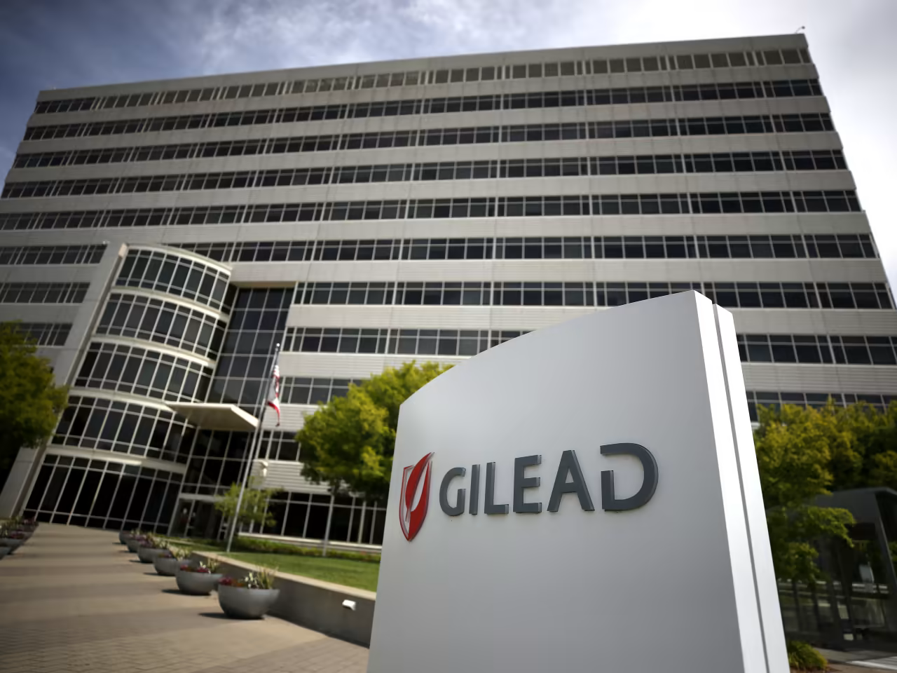
ABOUT GILEAD SCIENCES
A renowned research-based biopharmaceutical company committed to discovering, developing, and commercializing innovative medicines.
PURPOSE AND MISSION
Gilead Sciences' mission is to take on the world's biggest health challenges and create a healthier world for all individuals. Guided by their purpose, Gilead has been setting and achieving ambitious goals and works tirelessly to achieve them to create a healthier world for all people.
KEY THERAPEUTIC AREAS
Gilead Sciences focuses on several key therapeutic areas, including HIV, viral hepatitis, cancer, and other life-threatening diseases. By concentrating their efforts in these areas, Gilead aims to make significant advancements in patient care and treatment outcomes.

Slide 3

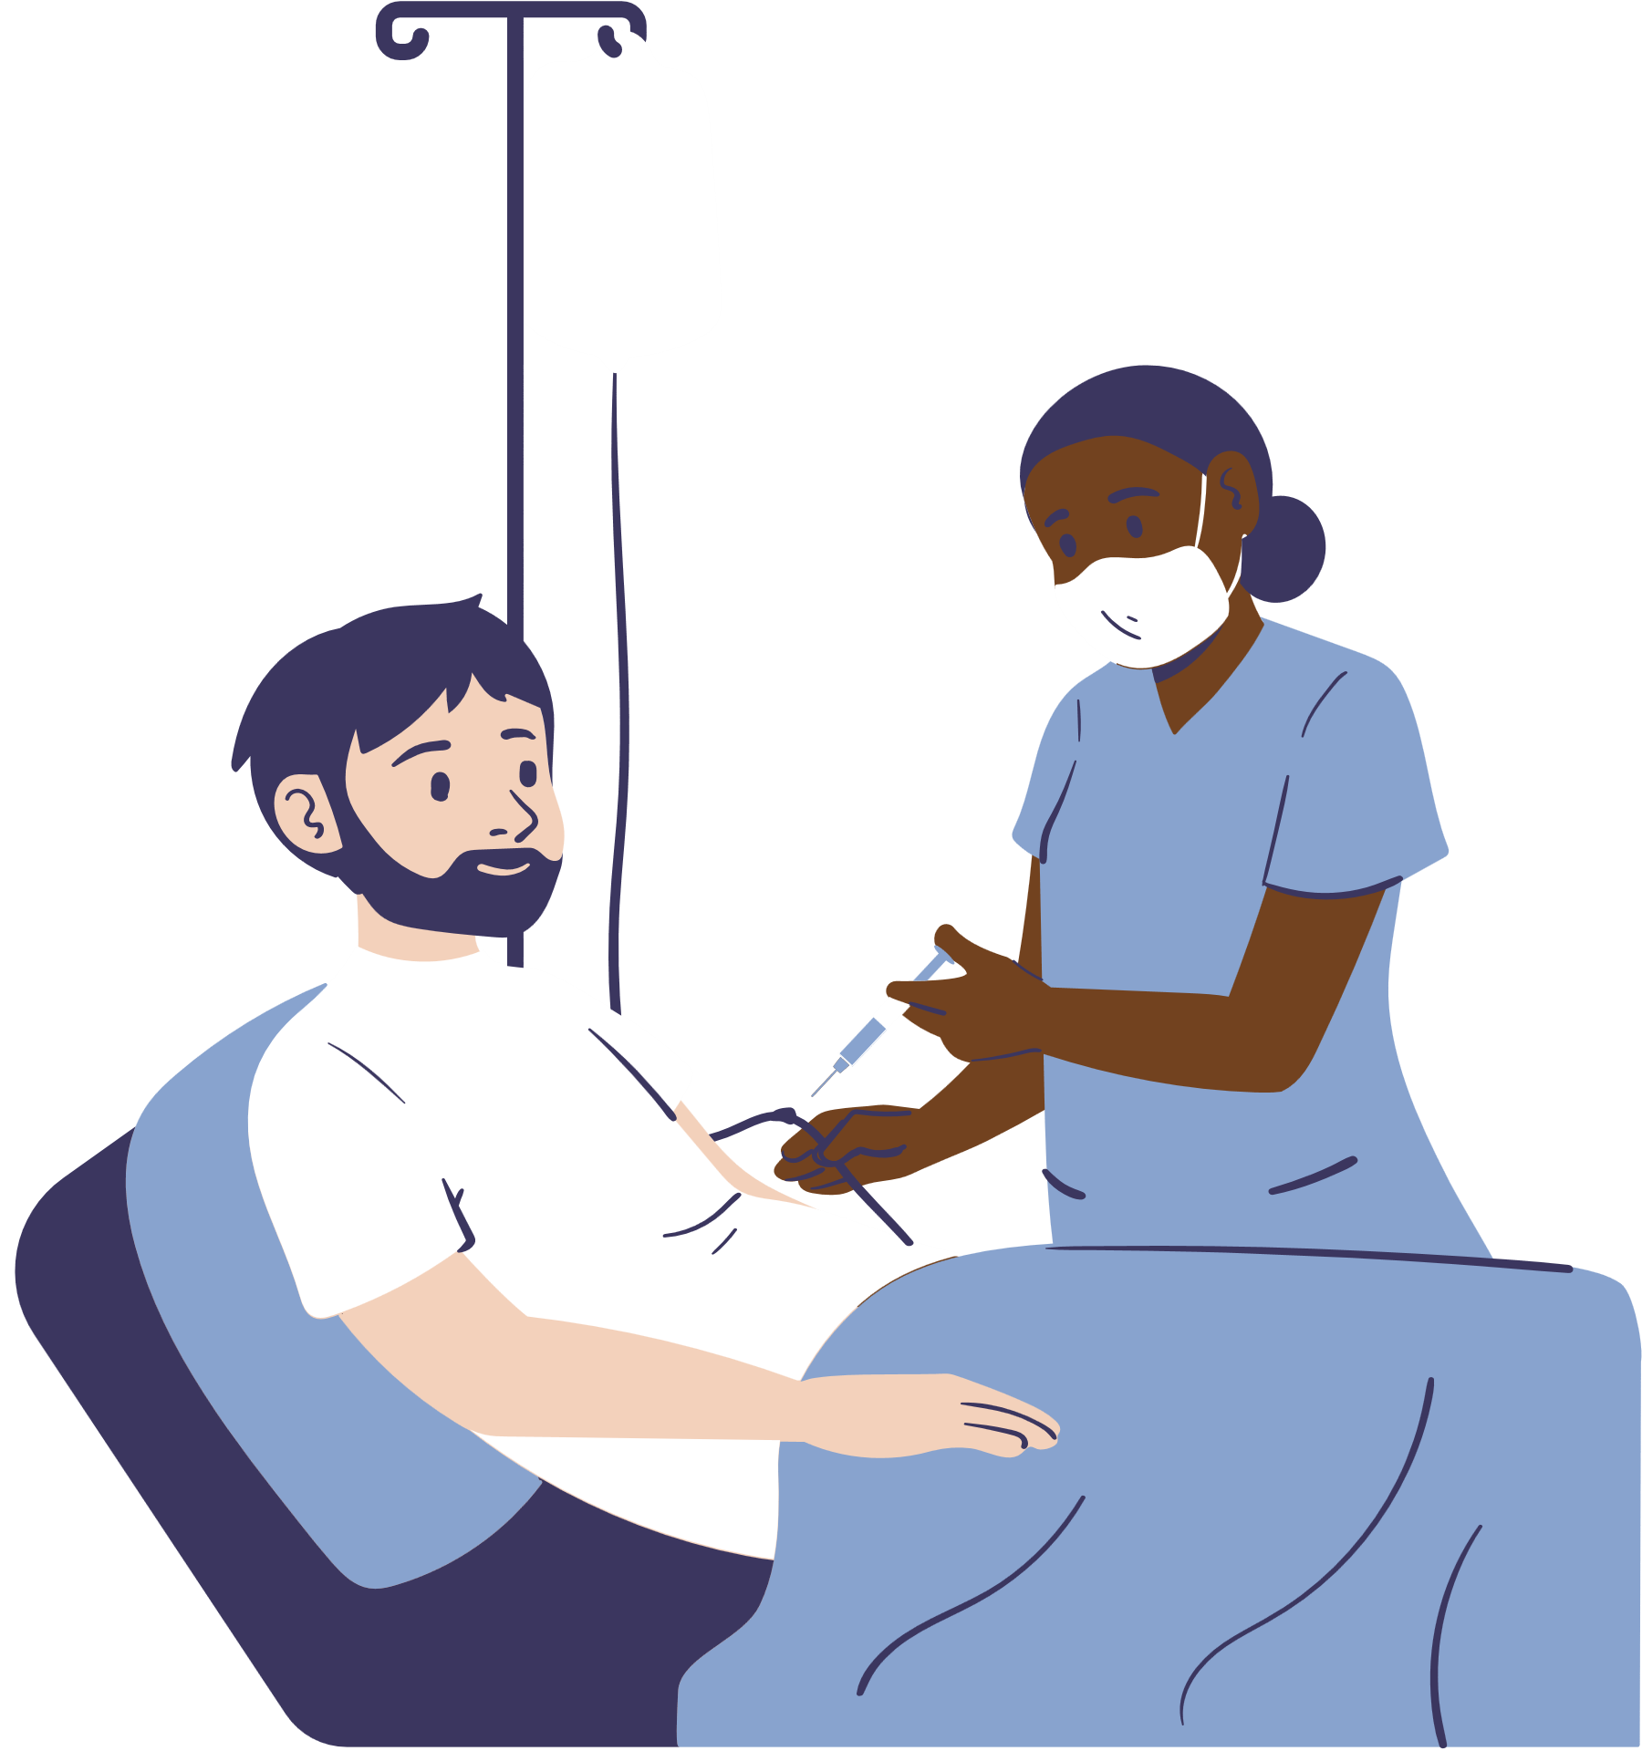



NOTABLE DRUGS & FORMULAS
01
BIKTARVY® -HIV TREATMENT
02
TRODELVY® - BREAST CANCER TREATMENT
03
REMDESIVIR - COVID19
Biktarvy® developed by Gilead Sciences for HIV-1 treatment have demonstrated high efficacy and durable viral suppression at five years in treatment-naïve adults.
Trodelvy® represents a significant advancement in the treatment of metastatic breast cancer, as in the Phase-3 studies, Trodelvy® demonstrated a durable overall survival advantage, offering hope to patients facing this challenging condition.
Phase 3 studies for Remdesivir, an investigational antiviral drug
against COVID-19, with ongoing research and clinical
trials to assess its
effectiveness and
safety in treating
the virus.

Slide 4





Collaboration
Gilead
Sciences
Amazon
AWS
Data Infrastructure Modernization on AWS
Enterprise Search Tool Using Machine Learning
Gilead Sciences recognizes the importance of streamlined and democratized data access in driving innovation and discovering drugs with
higher efficacy. Through a partnership
with AWS, Gilead has modernized
its data infrastructure, enabling
faster and more efficient data
analysis.
To enhance workflows, increase staff productivity, and reduce costs associated with document processing, Gilead Sciences leveraged machine learning on AWS to develop an AI-powered enterprise
search tool. This tool enables
quick and accurate retrieval of
information, empowering
employees to make informed
decisions.

Slide 5


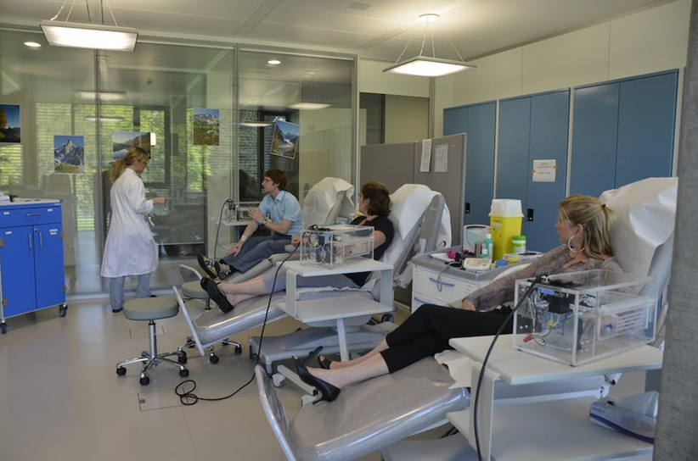

Clinical Trials and Research Initiatives
Gilead Sciences invests heavily in clinical trials and research initiatives to continuously drive medical advancements. By collaborating with leading institutions and researchers worldwide, Gilead aims to expand treatment options and improve patient outcomes.
Patient Support and Advocacy Programs
Gilead Sciences is dedicated to supporting patients and advocating for their needs. Through various programs and initiatives, Gilead ensures access to life-saving treatments and provides resources for disease management, education, and emotional support.

Slide 6
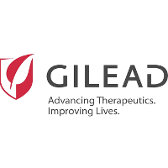




CONCLUSION
In conclusion, Gilead Sciences remains committed to advancing innovative medicines, addressing global health challenges, and creating a healthier world for all individuals. With a strong focus on key therapeutic areas and recent breakthroughs in HIV, COVID-19, and oncology treatments, Gilead is poised to make significant contributions to the field of biopharmaceuticals.
REFERENCES
For references,
please scan the
QR Code.

